Slide 1
FOUR RADIO COMMUNICATION OPTIONS
Each concept connects the driver and pit crew using a different radio or headset setup.
A
MURS RADIO KIT
BTECH MURS-V2 radios with a Rugged helmet kit and wheel push-to-talk button. An external antenna gives more flexibility in radio placement.
B
FRS RADIO KIT
FRS radios with the same basic helmet-audio and push-to-talk setup. The fixed antenna makes the radio’s mounting location important.
C
BLUETOOTH MESH
Cardo Packtalk Outdoor units provide hands-free communication. No cable connects the driver to the car, but range and battery life need testing.
D
DEDICATED RACE RADIO KIT
A matched Rugged driver-and-crew package combines radios, headsets and wiring. One supplier can simplify installation and compatibility checks.
01

Slide 2




MURS RADIO KIT
MURS radios connect helmet audio to a pit headset, with a steering-wheel push-to-talk button.
IN THE CAR
IN THE PIT
Helmet kit
Speakers + mic in the padding
Car harness
Rugged driver kit
Radio jumper
Kenwood 2-pin plug
Quick release cord
RULES COVERED
Helmet B.5.1 · Egress Tech B.8.1 · Refuel D.8.3.7.2 · Battery B.10.1.1.7
PTT button
Velcro on the wheel
BTECH MURS-V2
Inside the frame, secured
Crew headset
2-pin, with PTT
SMA coax
MURS link · 2 W
Est. 1.6–8 km
(1–5 mi)
Cage antenna
Clear of transponder and RFID tag
BTECH MURS-V2
Pit radio
01
An external antenna allows flexible placement. Replaceable batteries simplify servicing. Verify range and engine-noise clarity.
02

Slide 3
FRS RADIO KIT
Compact FRS radios use the same driver headset and push-to-talk arrangement as the MURS option.
IN THE CAR
IN THE PIT
Helmet kit
Speakers + mic in the padding
Car harness
Rugged driver kit
Radio jumper
Kenwood 2-pin plug
Quick release cord
FRS link · 2 W
Est. 2.4–4.8 km
(1.5–3 mi)
RULES COVERED
Helmet B.5.1 · Egress Tech B.8.1 · Refuel D.8.3.7.2 · Battery B.10.1.1.7
PTT button
Velcro on the wheel
BTECH FRS radio
Mounted high, clear view
BTECH FRS radio
Pit radio
Crew headset
2-pin, with PTT
02
Rechargeable units are easy to replace. Check fixed-antenna placement, audio compatibility and course coverage.
03

Slide 4
BLUETOOTH MESH COMMUNICATION
Cardo units provide hands-free communication without a cable between the driver and vehicle.
ON THE DRIVER
IN THE PIT
Built-in battery
About 10 hr talk time
Bluetooth mesh
Rated ~1 km
(0.6 mi) per hop
RULES COVERED
Helmet B.5.1 · No cord to unplug at egress or refuel
Speakers + mic
Mounted in the helmet
Cardo Packtalk
Clamped to the helmet
Cardo Packtalk
Pit crew unit
Extra units
Optional relays
03
Fewer cockpit wires simplify entry and exit. Verify range and noise performance and plan charging for long events.
04

Slide 5
DEDICATED RACE RADIO KIT
A matched Rugged kit combines radios and audio hardware to simplify installation and troubleshooting.
IN THE CAR
IN THE PIT
Helmet kit
Included in the kit
Car harness
Included in the kit
Radio jumper
Included in the kit
Quick release cord
Business band · 5 W
FCC license needed
Range not published
RULES COVERED
Helmet B.5.1 · Egress Tech B.8.1 · Refuel D.8.3.7.2 · Battery B.10.1.1.7
PTT button
Included in the kit
Rugged R1 radio
In the kit’s aluminum box
Rugged R1 radio
On the crew radio belt
H42 crew headset
Coil cord, with PTT
04
One supplier reduces connector uncertainty. Confirm the kit configuration, frequency authorization and course coverage.
05

Slide 6
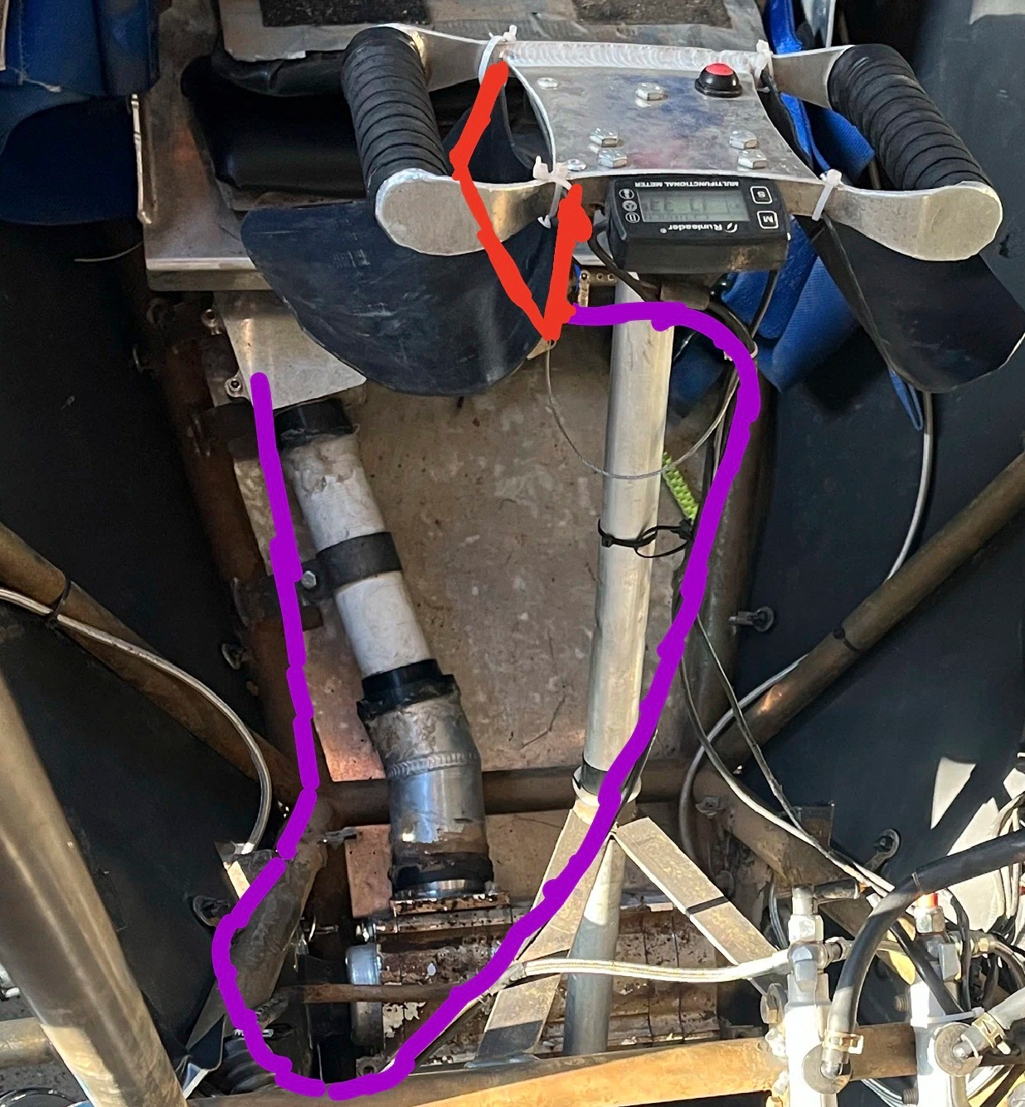
STEERING-WHEEL 4WD ENGAGEMENT
Proposed location: behind the steering-wheel rim, within finger reach
A locking lever near the steering wheel would pull the cable to engage 4WD. Its latch holds engagement without continuous finger pressure.
Cable routing gives flexibility around the frame. Squeezing again releases the latch and lets the spring return the selector, assuming its return position is 2WD.
06

Slide 7
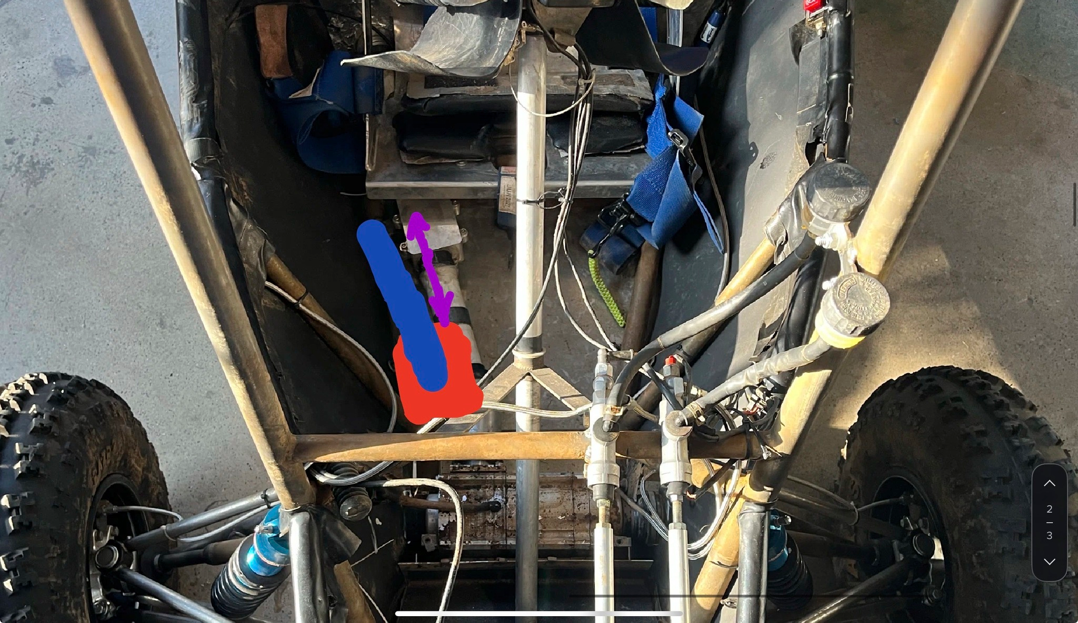
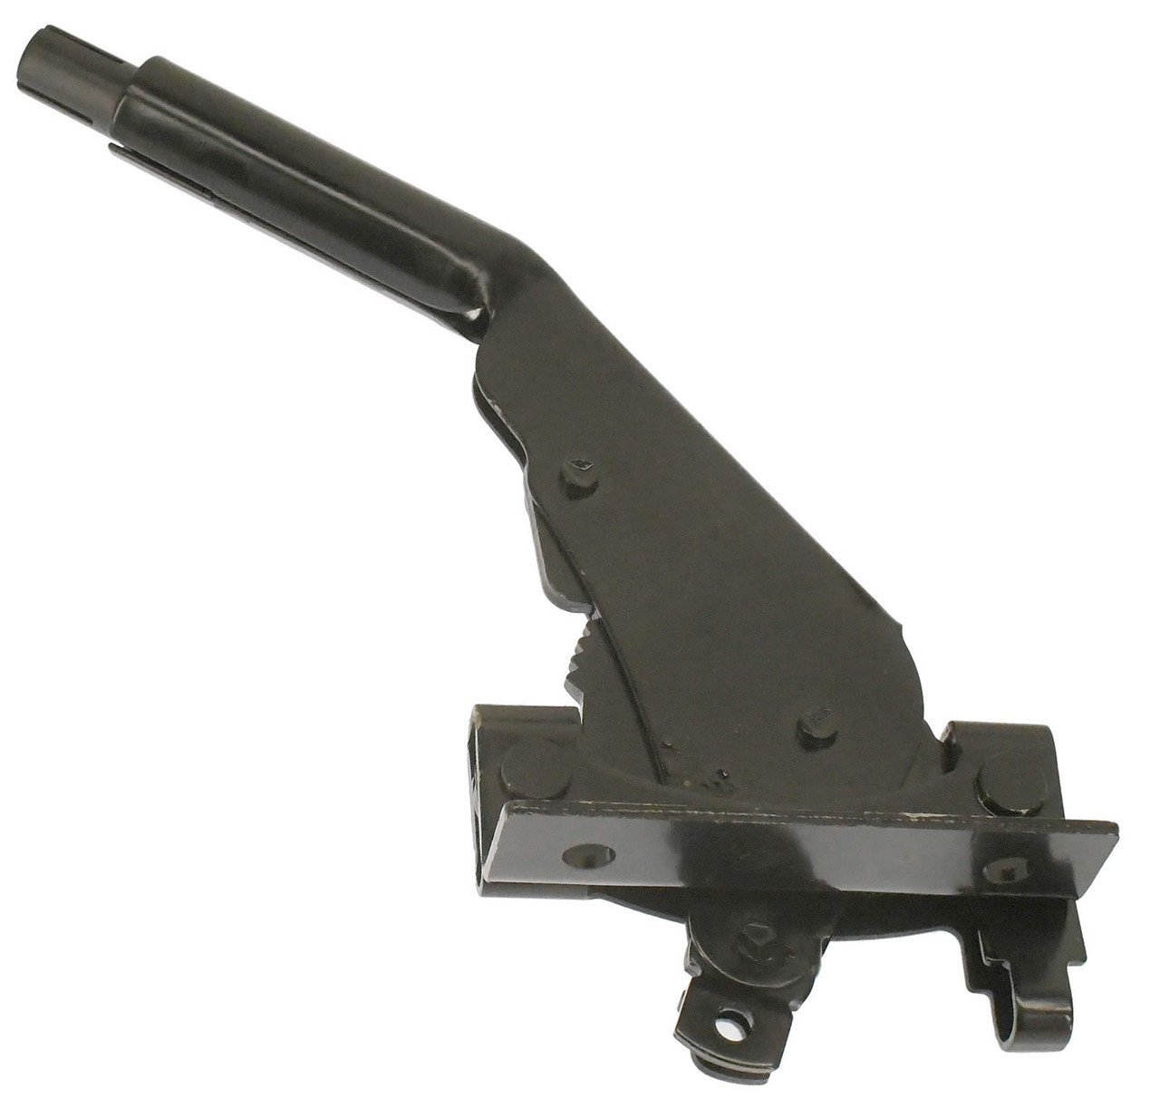
FLOOR-MOUNTED SOLID 4WD SHIFTER
Proposed location: floor-supported bracket beside the driver’s right thigh
A floor-mounted lever beside the driver would move the 4WD selector through a rigid rod. A longer handle could reduce operating force.
Rigid linkage gives direct feedback and avoids cable stretch. Adjustable joints simplify setup, while a latch holds engagement against the return spring.
07

Slide 8
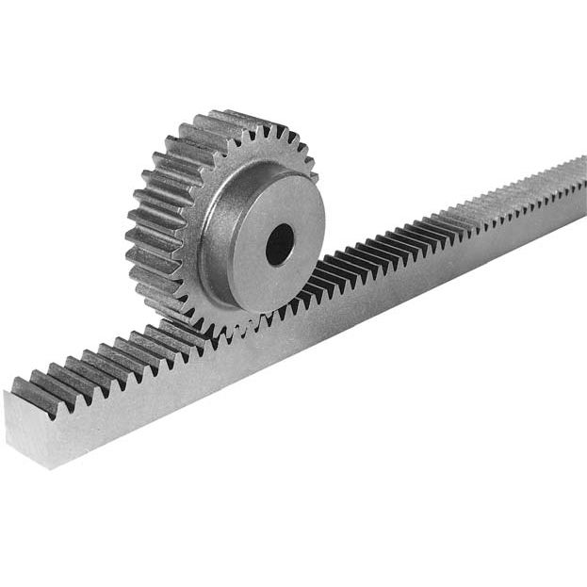
SPUR GEARS FOR THE STEERING RACK
Location: inside the steering-rack housing, at the base of the steering column
A spur pinion and straight-tooth rack convert steering rotation into sideways rack movement. Straight teeth simplify manufacturing and avoid helix-induced axial thrust.
Standard components could ease sourcing and replacement. Pinion size controls the effort–travel tradeoff, while proper support and adjustment help limit free play.
08

Slide 9
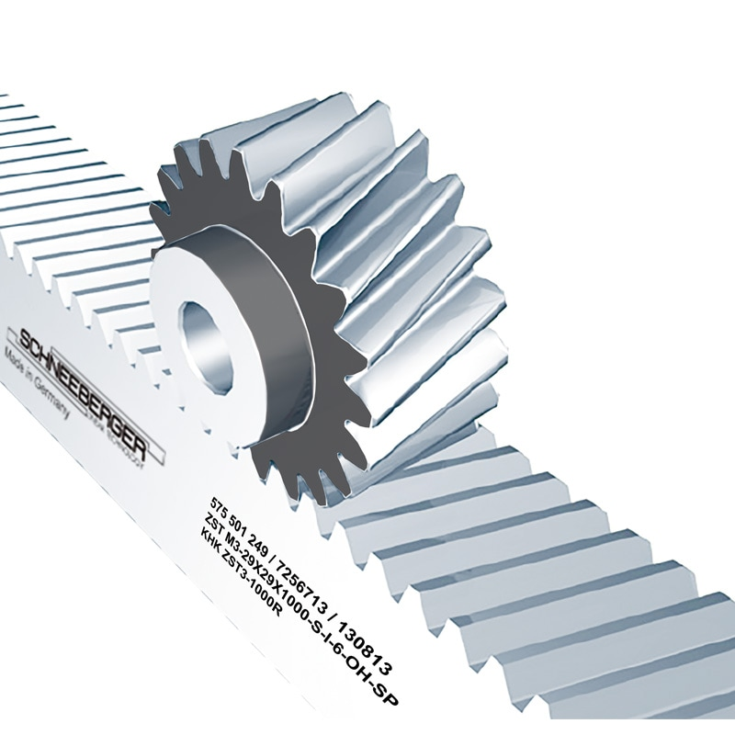
HELICAL GEARS FOR THE STEERING RACK
Location: the same rack housing, using a matched angled-tooth rack and pinion
Angled teeth engage progressively and share load across more contact. This could make steering feel smoother and reduce gear-meshing vibration.
Helical gearing needs bearings that support axial thrust and a stiff housing. Test whether the smoother engagement justifies the added complexity.
09

